Slide 1
What’s New in PowerShell
Joey Aiello
Program Manager

Slide 2
The Power of the Shell
PowerShell enables you to manage and automate your servers, clouds, hypervisors, networks, and much more!

Slide 3
The Power of the Shell
… We were able to scale up from supporting 3 test environments to 30, with the same number of people! …
PowerShell got me a promotion to the Windows Engineering Team
… Picked up automation and scripting with Powershell, my pay tripled! …
.. It has helped my company save Time, Efforts and Money for all our customers …
… Estimating several weeks to complete the migration to the cloud. With the use of DSC, I was able to migrate in about an hour …
https://aka.ms/PowerShell/HeroStories

Slide 4
PowerShell Themes
Ubiquity
Agility
Community

Slide 5
Cloud changes everything
It’s 2018 and PowerShell has never been more important
Digital Transformation changes everything
Automation enables Digital Transformation

Slide 6
New Mission - Support Digital Transformation
From ANY client
Manage ANY server
Running on ANY cloud
Or on-prem using:
ANY hypervisor
ANY storage
and ANY networking

Slide 7
Shifts in Management
PowerShell Core
Windows PowerShell
Windows system mgmt.
Managed low-level infrastructure (e.g. Storage, Networking, etc.)
PowerShell managed disparate APIs on Windows
Cloud resource mgmt.
Heterogeneous world of REST APIs (e.g. Azure/ARM, other clouds, 3rd party SaaS services)
Lighter weight runtime optimized for containers/ephemeral runtimes
Cloud cadence requires agility in PowerShell
Native APIs
WMI/CIM
.NET APIs
XML
JSON
Win32
Data
CSV
SaaS
Other clouds
Azure

Slide 8
PowerShell Core Cross-platform, portable and open-source version of PowerShell built on .NET Core https://github.com/powershell/powershell
Announcement: PowerShell Core 6.1 Release
http://aka.ms/getPS6

Slide 9
PowerShell Core
PowerShell Core is the future of PowerShell built on .NET Core
Cross-platform
Run in whatever environment or OS makes sense for you
Self-contained and side-by-side
“No reboot” installation
Universal management platform independent of your OS
Open-source
Direct line to the PowerShell team
Share the collective contributions of the PowerShell community
Manage your heterogenous environments in the hybrid cloud
“Anything, anywhere”

Slide 10
PowerShell Core 6.0
January 10, 2018
Big features
First cross-platform release of PowerShell
Side-by-side and portable
SSH-based PowerShell Remoting
Massive improvements to REST/JSON cmdlets
And much more!
PowerShell Standard (SDK)
Universal modules for PowerShell Core and Windows PowerShell

Slide 11
Delighters
Joey Aiello

Slide 12
PowerShell Core 6.1
September 13, 2018
Improved Windows cmdlet coverage
Support for 1900+ (60%) inbox cmdlets in Windows Server 2019
Speed!
Experimental feature flags
Enables more velocity and experimentation in stable builds
Markdown support
Render and convert to Markdown from within the console
Built on .NET Core 2.1
Number of Windows Cmdlets
5500
Number of Months after 1st Release

Slide 13
Increased Coverage
Joey Aiello

Slide 14
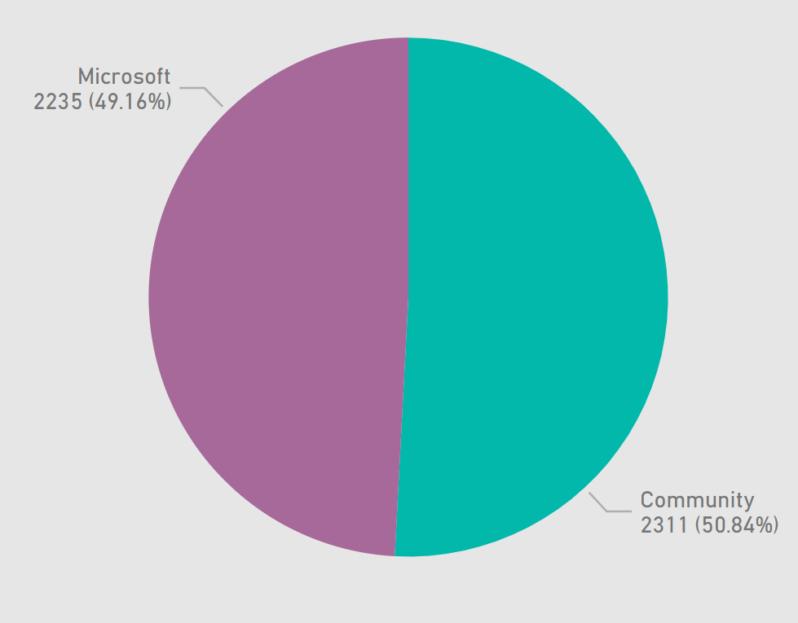
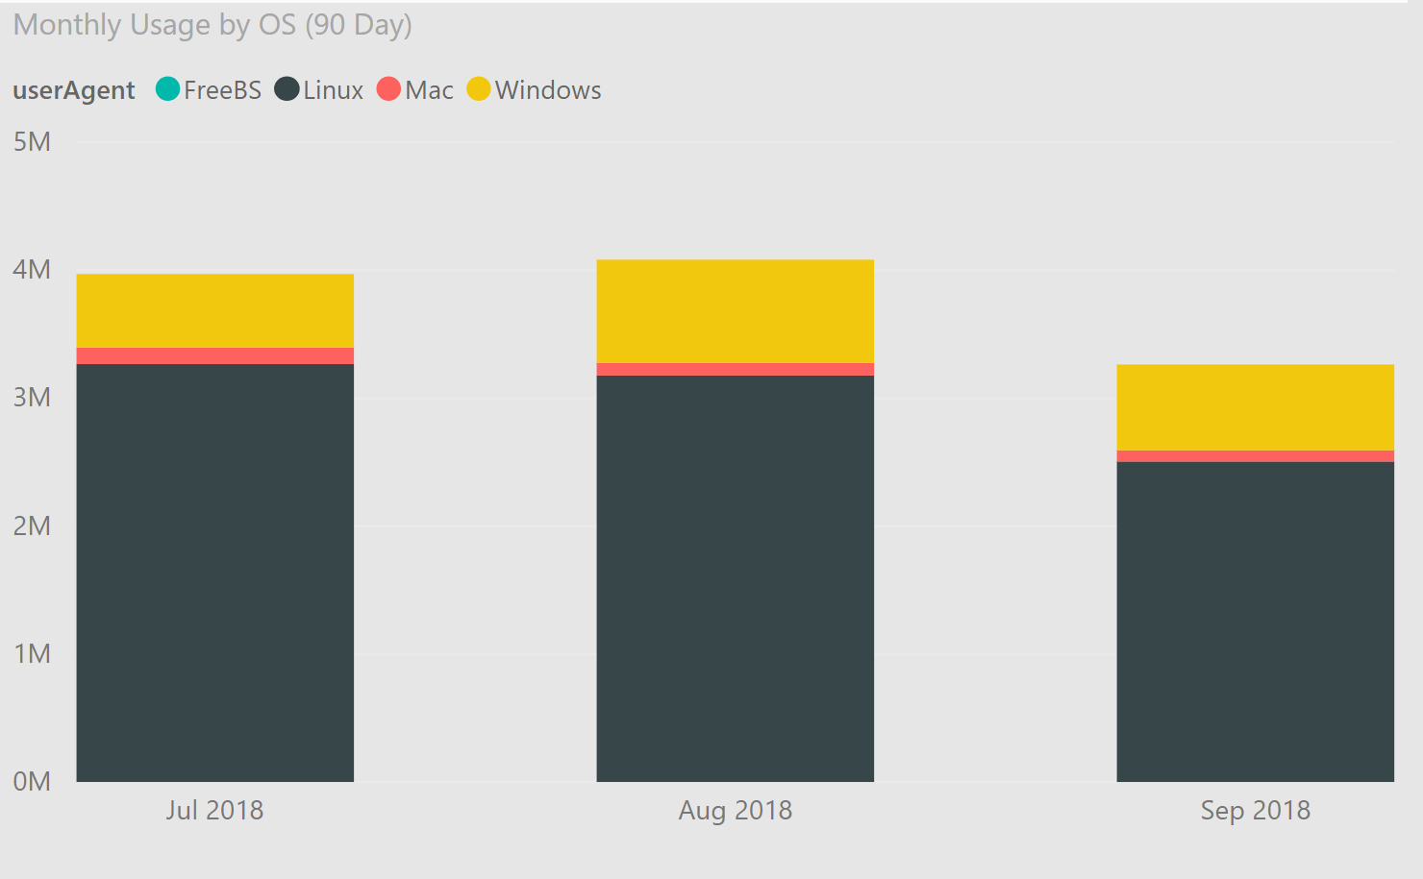
PowerShell Core – Community and Usage
Monthly usage by OS crossed 4m starts in Aug
80% on Linux
50% of Pull Requests coming from the community
https://aka.ms/PSGitHubBI

Slide 15
What About Windows PowerShell?
5.1 marks the completion of Windows PowerShell
Continue to support it and provide security fixes
 | Windows PowerShell | PowerShell Core
Cross-Plat Support | Windows only | Windows, macOS and Linux
Side-by-side |  | SxS and portable
Active development | Servicing only
Servicing | via Windows Update | via Microsoft Update
Remoting support | WinRM | WinRM and SSH
.NET CLR | .NET Framework | .NET Core 2.x
Packaging | Ships in Windows & MSU (for downlevel) | MSI, RPM/DEB repos, Snap, HomeBrew, ZIP

Slide 16
OpenSSH in Windows Provides an easy and secure remote management in hybrid environment https://github.com/PowerShell/Win32-OpenSSH
Announcement: Shipping in Windows 10 April Update and Server 2019
http://aka.ms/OpenSSHDocs

Slide 17
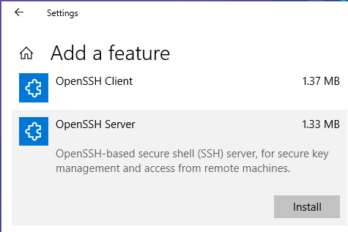
OpenSSH in Windows
OpenSSH is a suite of tools:
Remote authentication/administration
Multiple authentication mechanisms
Public/Private key management
Secure file transfers (sftp, scp)
Now ships in Windows
SSH client installed by default
SSH server available as Feature on Demand (FOD)
1803+
Thanks to the OpenBSD Foundation and community for creating and supporting OpenSSH and LibreSSL!

Slide 18
Cross-platform remoting
Hemant Mahawar

Slide 19
PowerShell Gallery The Place to Share & Acquire PowerShell Code https://www.powershellgallery.com
Announcement: UI Refresh of PowerShell Gallery

Slide 20
PowerShell Gallery
Hemant Mahawar

Slide 21
PowerShell Gallery
Downloads Per Month
27M
23M
19M
15M
11M
7M
3M
Since Feb 2015
235+ millions downloads
3900+ unique items
1350+ unique owners
Used by variety of enterprises :
Azure, AWS, VMWare, Dell, Citrix, HP, Google, Lenovo, etc.
Pairs with PowerShellGet cmdlets to search, acquire from, and publish to the PowerShell Gallery, or private repositories
Feb 2018
Mar 2018
Apr 2018
May 2018
Jun 2018
Jul 2018
Aug 2018

Slide 22
PowerShell in Azure Cloud Shell Your managed admin console in Azure https://shell.azure.com/powershell
Announcement: GA PowerShell in Azure Cloud Shell

Slide 23
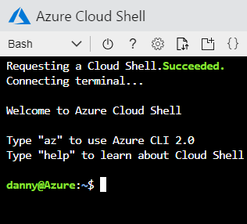
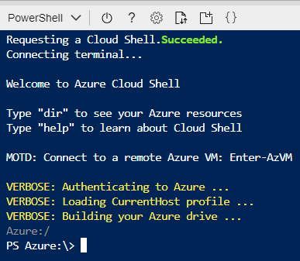
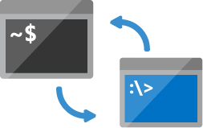
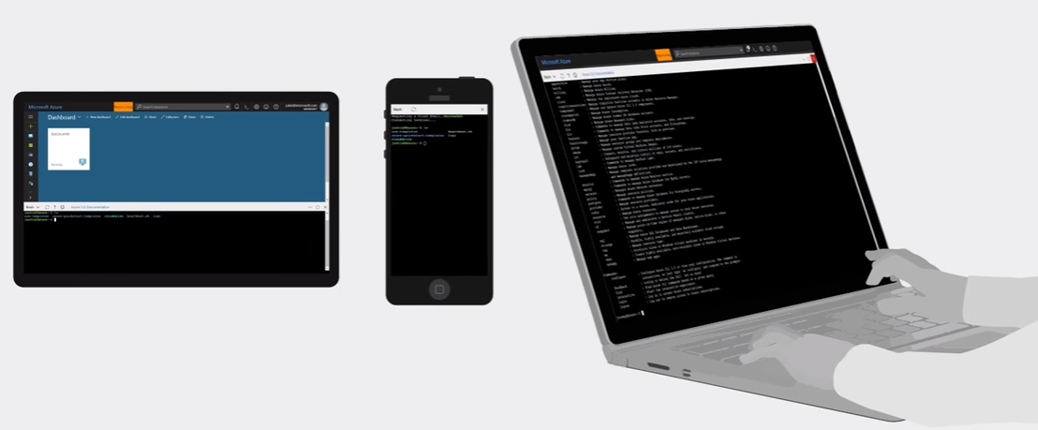
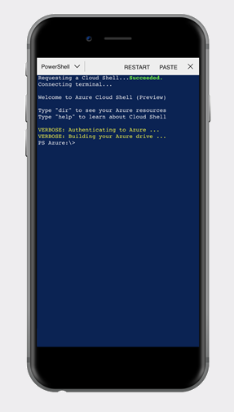
Azure Cloud Shell
Authenticated access
Choice of shell experience
Save your files into a private & secure Azure environment
Common tools & languages
Multiple integrated experiences
- Docs, VS Code, Azure App

Slide 24
PowerShell in Cloud Shell
Hemant Mahawar

Slide 25
PowerShell Themes
Agility
Community
PowerShell in Cloud Shell enables Azure management from any browser or phone
PowerShell integration in VS Code, docs.microsoft.com, Azure services
Ubiquity
PowerShell Core is supported on Linux, MacOS, and Windows
Faster release cycles and transparent development
Direct interactions with the PowerShell team
PowerShell in Cloud Shell is maintained by Microsoft with latest tools
Great OSS engagement
Tremendous usage of PowerShell Gallery for publishing and downloading PowerShell artifacts
User groups, PowerShell Conferences, Social media etc.

Slide 26
Announcements
GA - PowerShell Core 6.1
http://aka.ms/getpowershell
GA – PowerShell in Azure Cloud Shell
http://portal.azure.com
http://shell.azure.com/powershell
Refresh - PowerShell Gallery
http://powershellgallery.com
Shipping in Windows – OpenSSH
http://aka.ms/OpenSSHDocs

Slide 27
What’s next?
More integration with Azure services
PowerShell Core in Azure Functions 2.0
Remote management of Azure VMs with PowerShell and SSH
PowerShell Core 6.2 will be a minor release
Focus on stability/quality
Continued work with partner teams to increase coverage (e.g. Windows, Exchange, Intune)
Community pull requests
PowerShell in Cloud Shell
More tools and modules to get your job done
PSReadLine support in VS Code
Working with OpenBSD to upstream OpenSSH work

Slide 28
Azure security & management sessions
NEW
Governance
BRK3062 Tues 2:15PM
Architecting Security and Governance Across your Azure Subscriptions
BRK3085 Thurs 4PM
Deep dive into Implementing governance at scale through Azure Policy
BRK2476 Thurs 9AM
Make the most of Azure by optimizing your cloud spend through Azure Cost Management and Reserved Instances
Security
BRK2395 Wed 9AM Azure Security fundamentals: Protecting infrastructure, apps, and data in the cloud
BRK2038 Wed 2:15PM Simplify protection of cloud resources with Azure Security Center
BRK2368 Tues 9AM Practical guide for using Azure Security Center to protect hybrid cloud environment
(workshop: WRK2010 Tues 10:45AM)
BRK3059 Thurs 3:15PM Manage keys, secrets, and certificates for secure apps and data with Azure Key Vault
Monitoring
BRK2270 Tues 4PM
Full stack monitoring across application, infrastructure and network with Azure Monitor
(workshop: WRK2012 Wed 9AM)
BRK3354 Thurs 10:15AM
Monitor your infrastructure and analyze operational logs at scale with Azure Monitory
BRK3349 Tues 11:30AM
Everything about Azure Monitor telemetry and building integration with ITSM and SIEM tools
Resiliency
BRK3060 Mon 4PM Backup your data with Azure Backup (workshop: WRK2011 Wed 12:30PM)
BRK3078 Wed 11:30AM Ensure application availability with cloud-based disaster recovery, Azure Site Recovery
BRK3064 Thurs 2:15PM Implement Cloud Backup and Disaster Recovery at Scale in Azure
Automate
BRK3063 Fri 12:30PM
Azure Update, Inventory, and Automation for Linux and Windows VM management
BRK3069 Wed 4PM
What's new in PowerShell
Learn more about Azure Automation
Hands on experience
Learn more about Azure Governance
Learn more about Azure Security
Learn more about Azure Monitor
Learn more about Azure resiliency
Security & management hands on labs (to be updated CY18 Q4)

